Slide 1
WeatherScope: City-Based Weather Forecasting and Visualization Application
Ahmet Burak Biçer
210101161

Slide 2
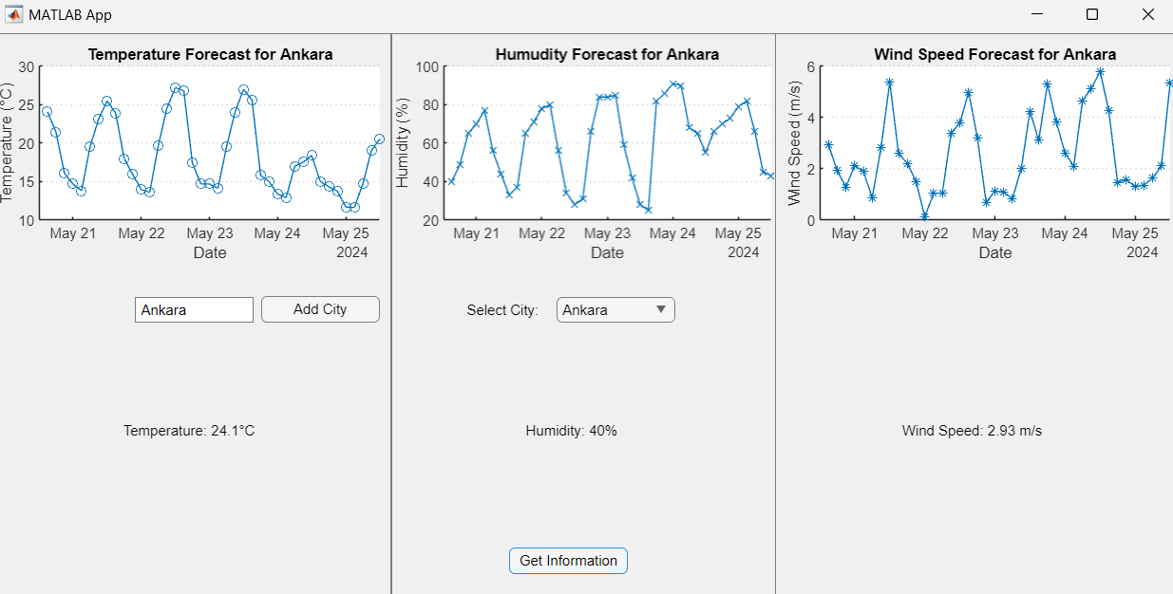
Overview

Slide 3
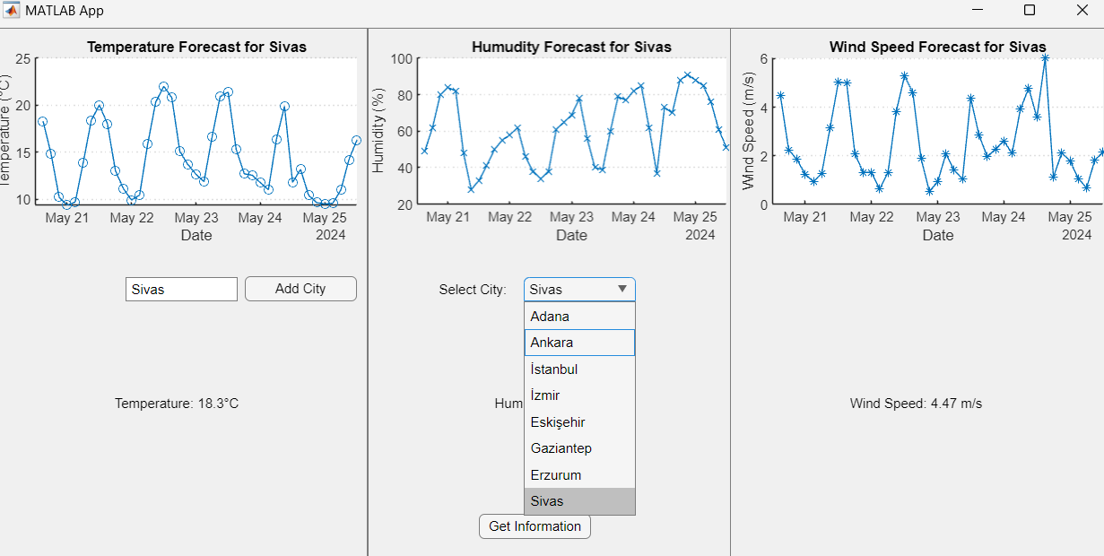
Dropdown Menu

Slide 4
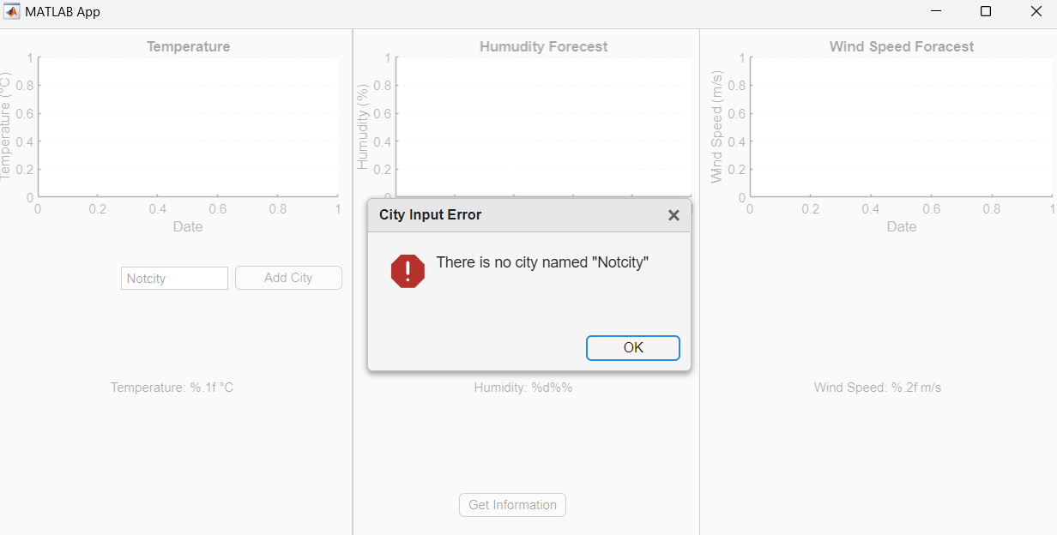
Handling Errors: There is no City Error

Slide 5
In the previous slide, I tried to add a city named ‘Nocity’ to the dropdown menu. Because of the there is no city named ‘Nocity’ the application warned me.

Slide 6
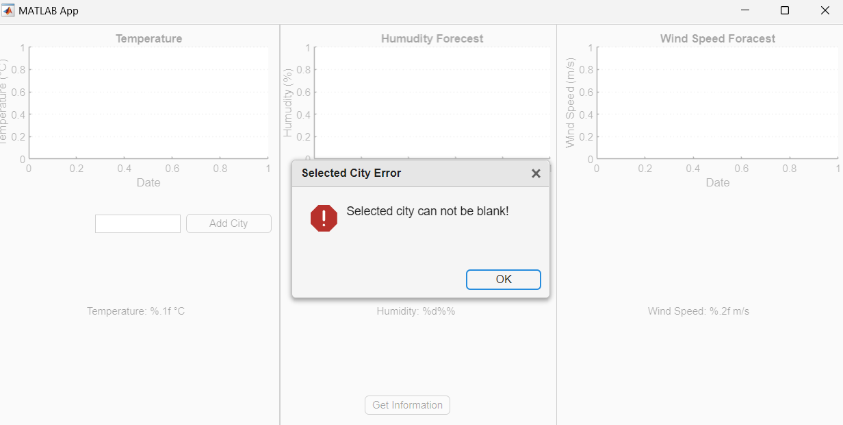
Handling Errors: Blank Selected City Error

Slide 7
In the previous slide, I straightly clicked to the ‘Get Information’ button before even added a city to the dropdown menu.
So the application warned me ‘Selected city can not be blank!’.

Slide 8
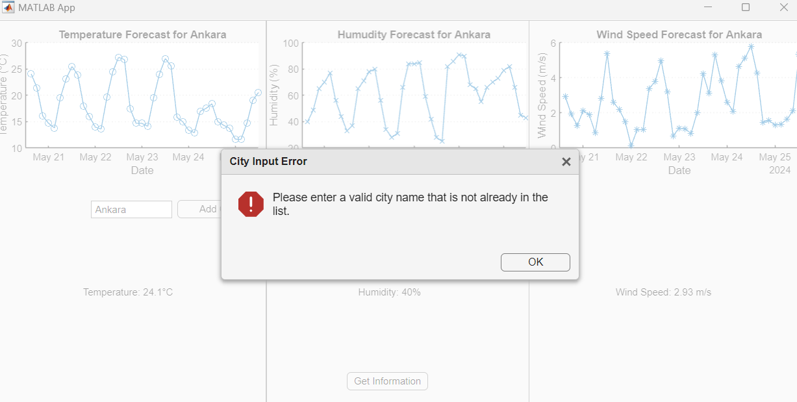
Handling Errors: City Already in the List

Slide 9
In the previous slide, I tried to add a city that already added.
I didn’t allow exactly duplicated city names in this application to achieve more clear interface.
So the application warned me ‘Please enter a valid city name that is not already in the list’

